Slide 1
GitHub
Intro to apis – class 2

Slide 2

Source code
“Source code” is a fancier way of saying “code” in the conventional sense.
No, I’m not kidding.
It is defined as any collection of computer instructions (possibly with comments) written using some human-readable computer language, usually as text.
Some examples of this are C#, C++, HTML, Python, JavaScript, and so on.

Slide 3


Software packages
A software package is an assemblage of files, as well as information about those files (metadata).
Metadata is data that summarizes basic information about other data, making finding & working with instances of said data easier– for example, the date it was created, author, file type (like .gif, .cpp, .xml, .pdf…) and so on.

Slide 4
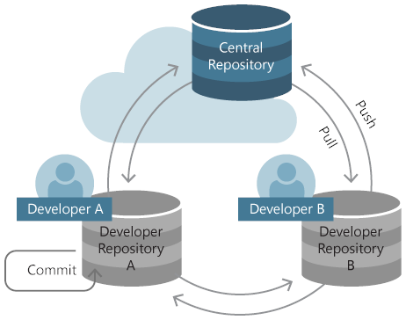
Software Repositories
A software repository is a storage location for software packages. A software repository is a central place to keep resources that users can pull from when necessary. Software repositories serve the general purpose of promoting collaborative use by offering remote access to software packages.
A software package is a group of programs (in folders and written on files) which are bundled together to serve a common purpose.
A software repository is also known as a code repository.

Slide 5

What is github?
GitHub is a website and cloud-based service that helps developers store and manage their code, as well as track and control changes to their code. To understand exactly what GitHub is, you need to know two connected principles:
Version control
Git

Slide 6
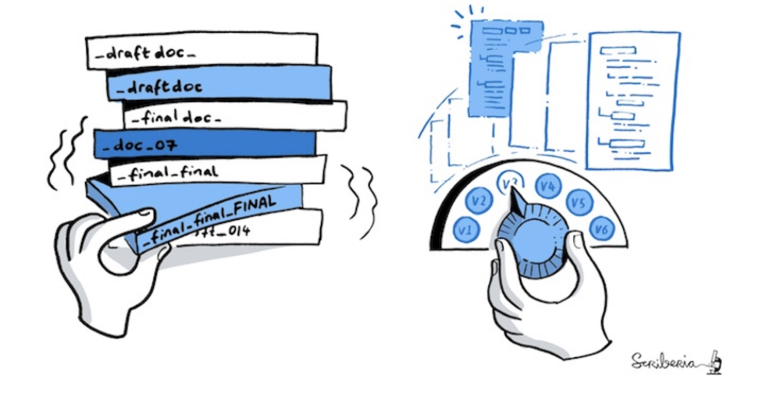
Version control
Version control (also known as source control) is the practice of tracking and managing changes to source code.
You should use version control software for all code, files, and assets that multiple team members will collaborate on.
Version control systems are software tools that help software teams manage changes to source code over time.
They can be broken down into two main categories, centralized and decentralized (also known as distributed).

Slide 7
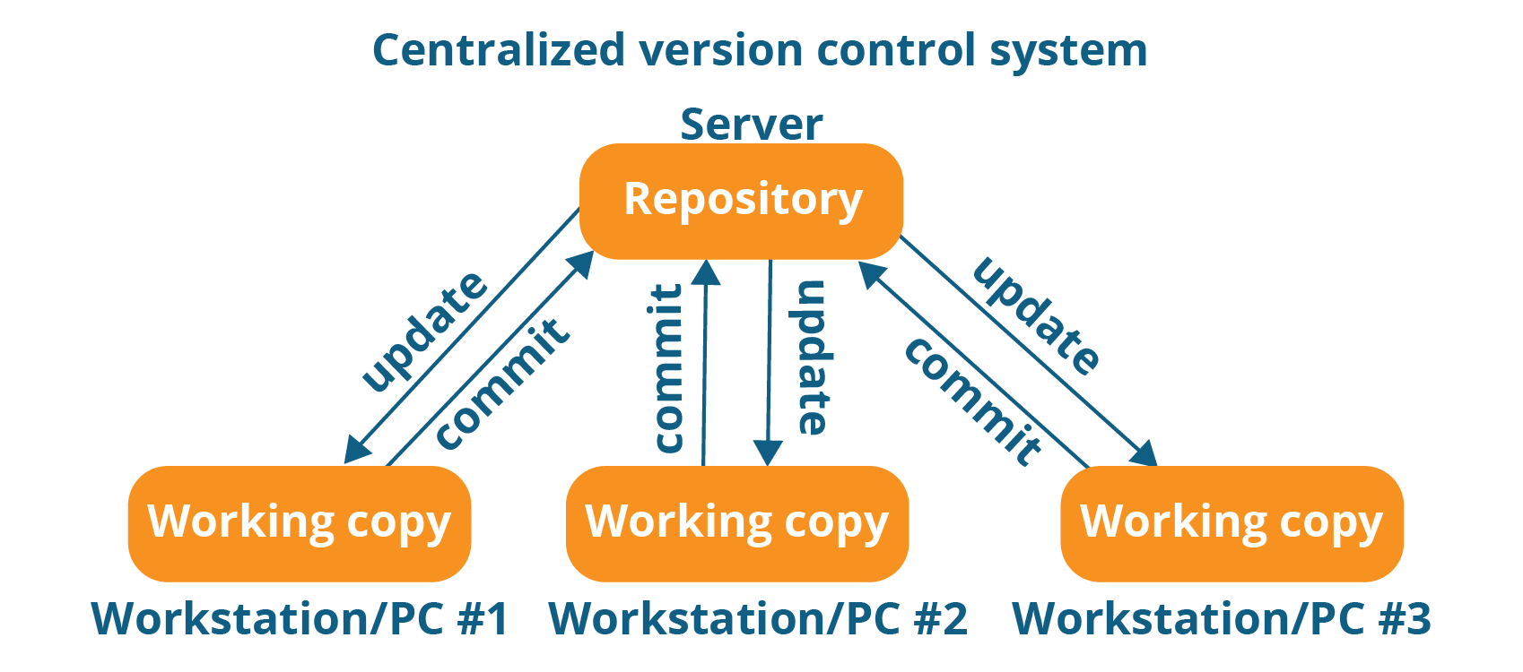
Centralized Version control
When centralized version control is implemented in a version control system, the central server stores all the data. This central server enables team collaboration. It just contains a single repository. Developers need to commit (a git command that captures a snapshot of the project's changes) and push directly to the remote repository.

Slide 8
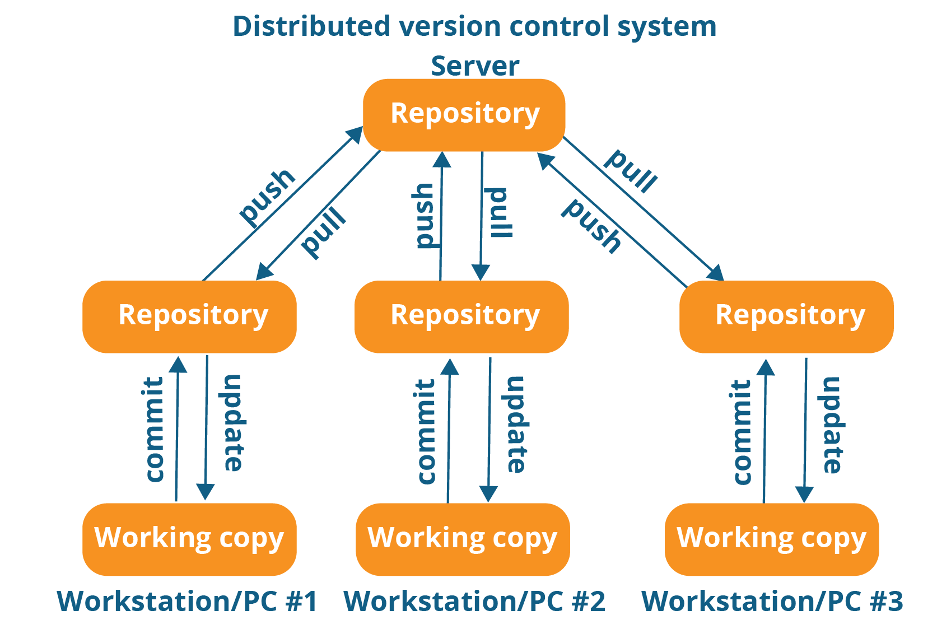
Distributed / decentralized Version control
Distributed / decentralized version control is a type of version control used by version control systems where the complete codebase — including its full version history — is mirrored on every developer's computer.
A developer using this type of version control can commit locally and later push all of those commits to the remote repository, rather than having to commit directly.

Slide 9
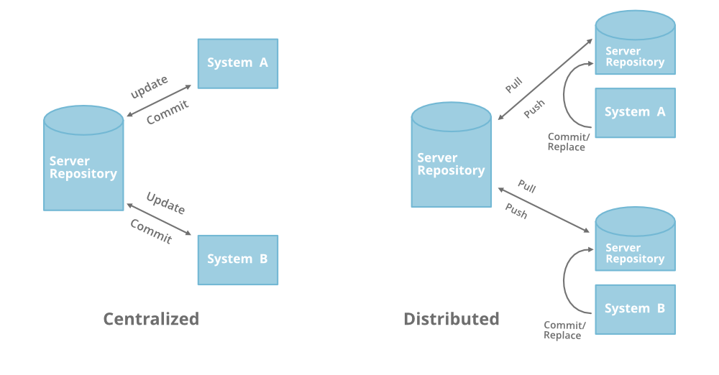
Centralized version control vs. distributed / decentralized version control
Centralized
Pros:
Easy to learn and manage
More control over users and their access.
Cons:
Must connect to the network to perform operations.
During an operation, if the central server crashes, there is a high chance of losing data.
For every command, the system connects to the central server, which impacts the speed of the current operation.

Slide 10
Centralized version control vs. distributed / decentralized version control
Distributed / Decentralized
Pros:
Except for pushing and pulling the code, the user can work offline.
Faster, because you don't have to contact the central server for every command.
Merging and branching are less costly.
Even if the main server crashes, code will be stored in the local systems.
Cons:
A potential side effect of being able to branch easily: you can have enough pending work that you lose track of it.

Slide 11

git
Git is currently the most used version control system. It tracks the changes you make to files, so you have a record of what has been done, and you can revert to specific versions should you ever need to. Git also makes collaboration easier, allowing changes by multiple people to all be merged into one source.
It is a distributed/decentralized version control system!

Slide 12
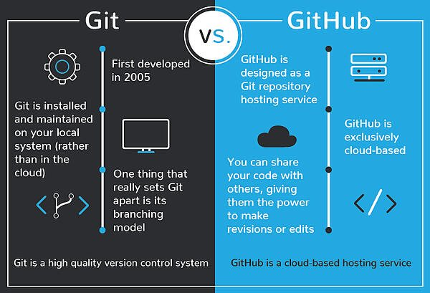
Git vs. github
Git is a version control system that lets you manage and keep track of your source code history.
GitHub is a cloud-based hosting service with which you can manage Git repositories. If you have projects that use Git, then GitHub is designed to help you better manage them.

Slide 13
Git branches
A Git Branch represents an independent line of development– it is nothing other than a version of your repository!
“Master” was the default naming convention for the branch that gets created when you make a repository. It is now called “Main.”
(We are getting rid of this naming convention, as it is considered to be slavery-origin terminology.)
main
main

Slide 14

Activity 2
Create a GitHub account on github.com
Submit the link to your profile to me. It should be github.com/yourusername
GitHub account = 50%, Repository (we are making this next) = 50%.
MAKE SURE YOUR ACCOUNT AND REPOSITORY ARE BOTH PUBLIC.
Verify your e-mail address.
Install Git onto your computer! Follow these instructions: https://git-scm.com/book/en/v2/Getting-Started-Installing-Git

Slide 15
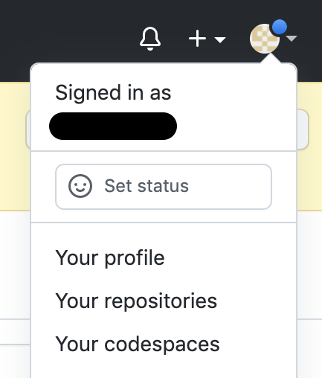
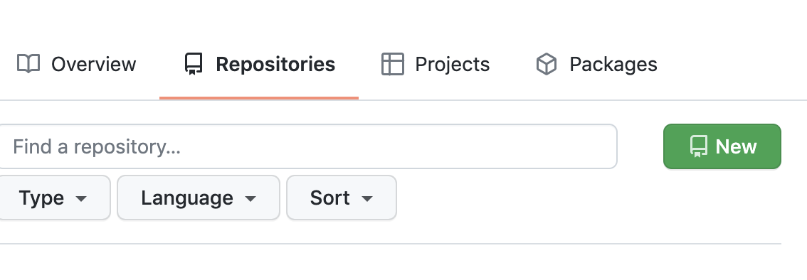
Creating your first repository
On the top-right corner of github.com, click on your profile icon to gain access to the user drop-down menu, then select Your repositories.
Select the green New button.

Slide 16
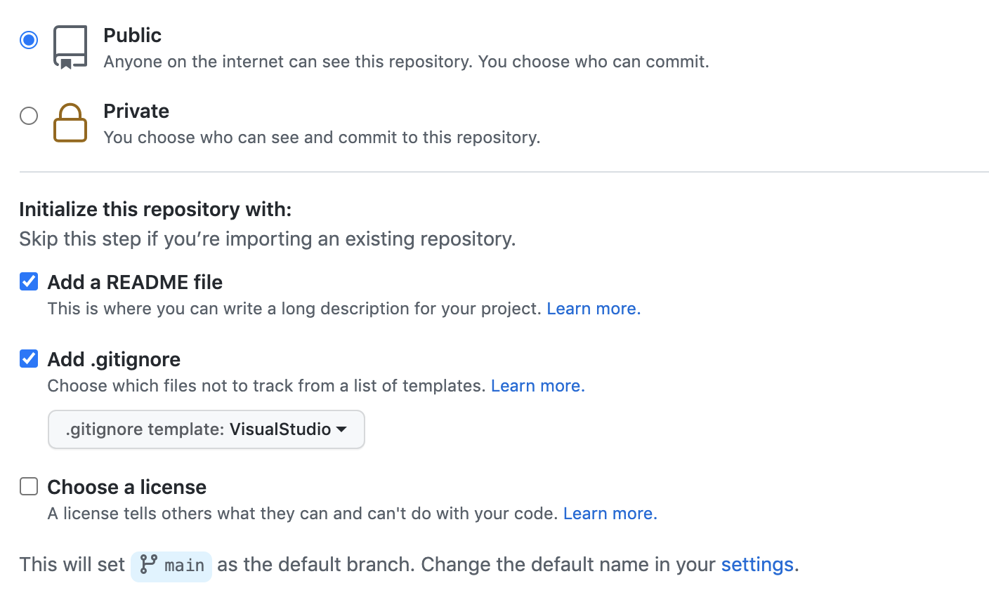
Creating your first repository
Name your repository SerraMadeMe
Make sure your repository is set to Public so that I’ll be able to see it.
Add a README file and add .gitignore. You can pick VisualStudio as the template for the .gitignore file, as this is the preferred template for applications using the .NET framework, which we will be implementing for our project.

Slide 17
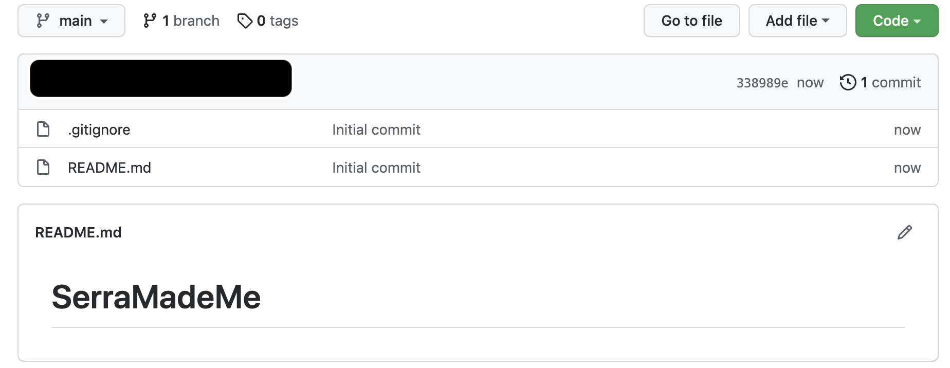
Your first repository
You only have one branch in your repository for now– your main branch.
A commit (remember, “snapshot”) creating the repository is visible here. These are all the commits for the main branch.
READMEs are set to display underneath your code for developers to be able to read.

Slide 18
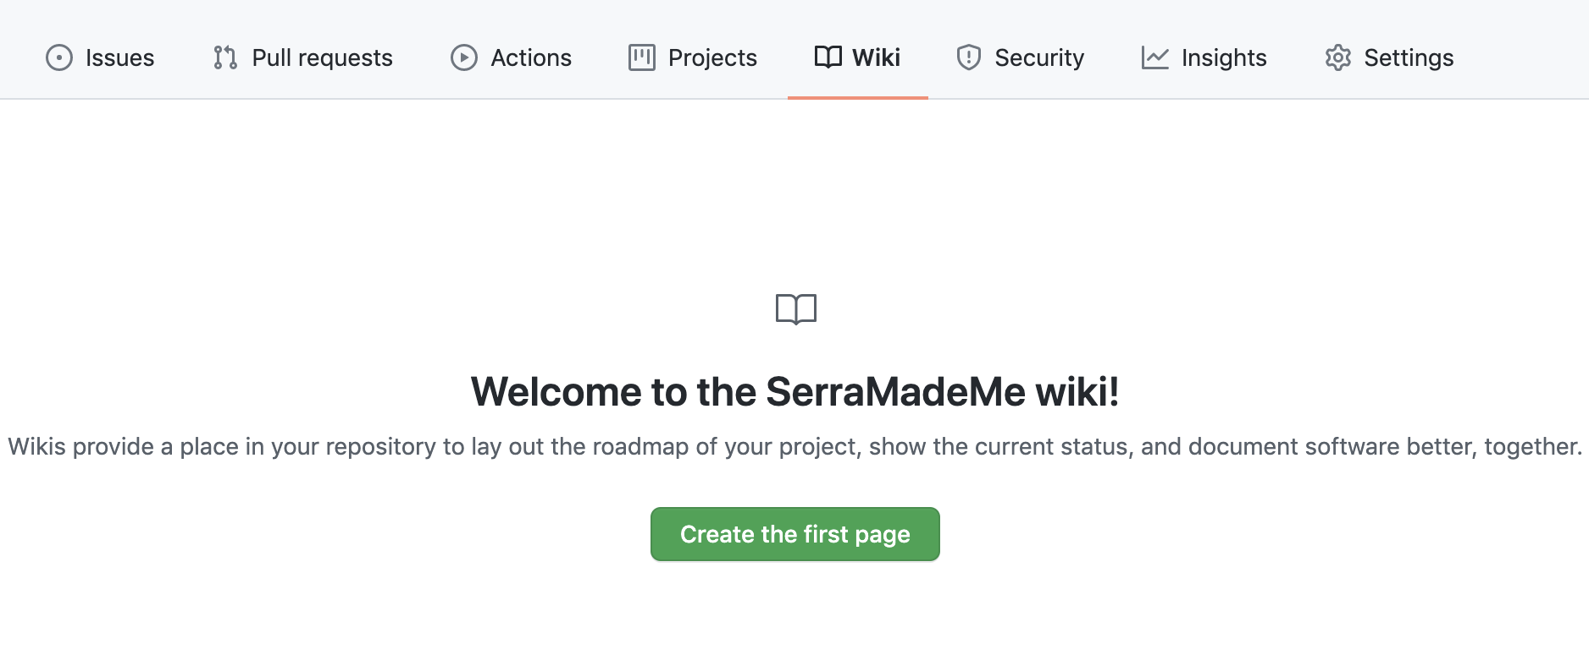
readmes
A README file is an essential guide that gives other developers a detailed description of your GitHub project. It is typically kept in your repository as a markdown file (.md), which is a lightweight markup language for creating formatted text.
A lot of the time, READMEs are written to help developers on a team set up and run the project.
GitHub Wiki is another resource that is created alongside a repository used to store information about said repository for developers to read. A GitHub Wiki is itself a Git repository.

Slide 19

.gitignore
The .gitignore file tells Git which files to ignore when committing your project to the GitHub repository.
The .gitignore file itself is a plain text document.
.gitignore is essential for files that contain sensitive information, such as passwords, encryption keys, etc.

Slide 20
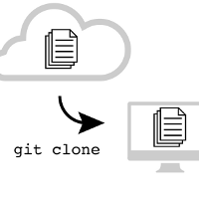
Cloning your repository
In order to pull your code down and do things to it, you’re going to want to use the git clone command in your terminal while in the directory you want your project to be in!
This command is primarily used to point to an existing repository and make a clone or copy of that repo in a new directory. The original repository can still be located on the local filesystem or on remote machine accessible supported protocols. The git clone command copies an existing Git repository.

Slide 21
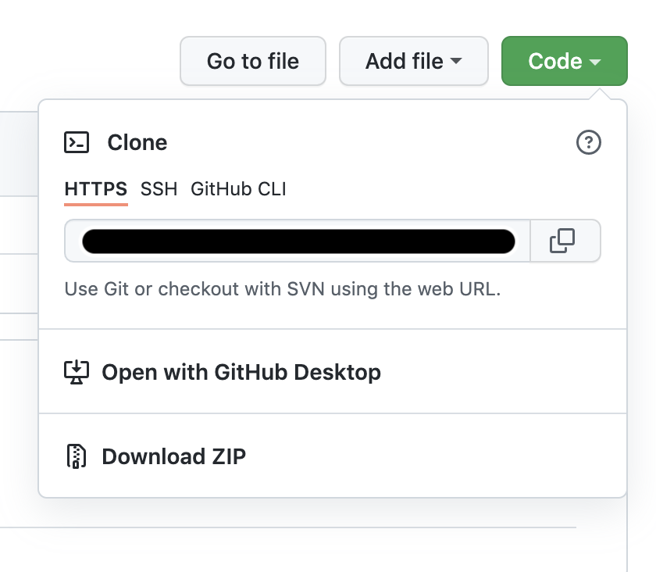
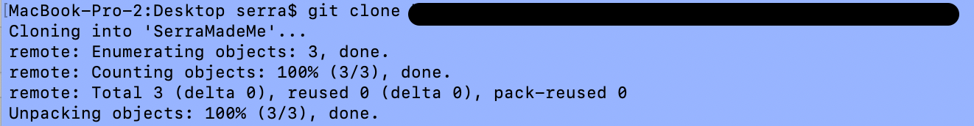
Cloning your repository
Link
Under the Code drop-down menu in a repository, a URL is provided that one can use it to set up a local copy of the project.
Link

Slide 22
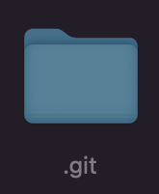
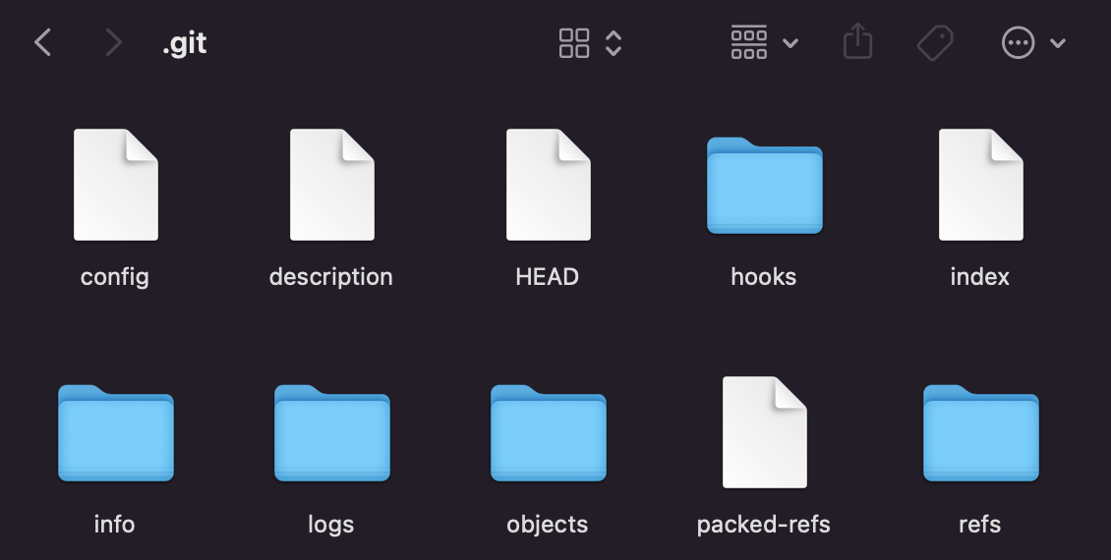
the .git folder
If you make all hidden items visible in your file explorer and look inside of a project, you should be able to see your .git folder. Look up what shortcut to use on your operating system to show hidden items and give it a try!
The . git folder contains all the information that is necessary for your project in version control and all the information about commits, remote repository address, etc. All of them are present in this folder. It also contains a log that stores your commit history so that you can roll back if you need to.

Slide 23
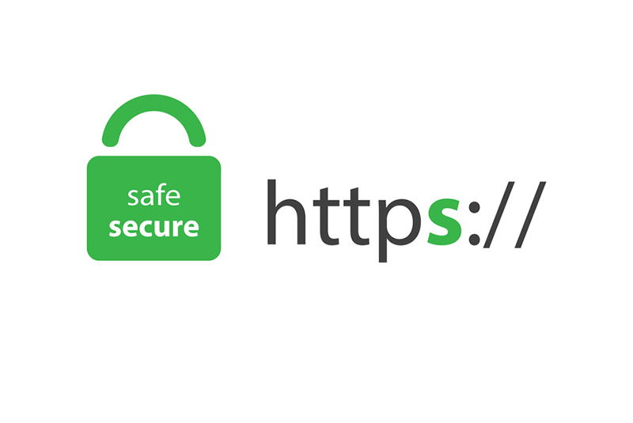
HTTPS
HTTPS is a secure version of HTTP that encrypts data sent between the client and server. Now, when hackers intercept that encrypted data, they are unable to make any sense of it and are unable to reverse it. SSH is also a secured version, where data sent between the client and server is encrypted.
Using an HTTPS remote URL has some advantages compared to using SSH. It's easier to set up than SSH, and usually works through strict firewalls and proxies. However, it also prompts you to enter your GitHub credentials every time you pull or push a repository. (This may be changed with the right settings depending on your operating system, though.)
When Git prompts you for your password, enter your personal access token (PAT) instead. Password-based authentication for Git has been removed, and using a PAT is more secure.

Slide 24
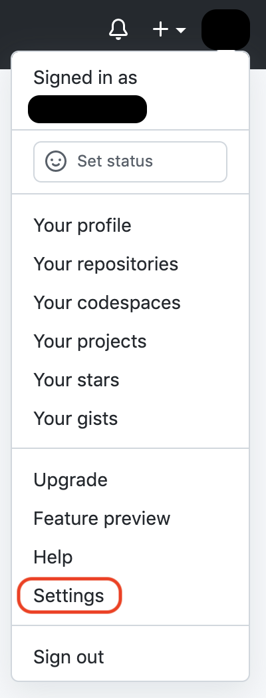
creating a personal access token (pat)

Slide 25
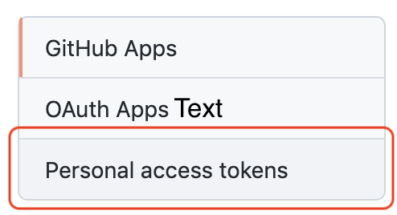
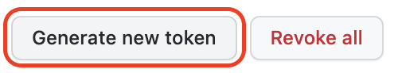
creating a personal access token (pat)
… Then configure your settings and create the token!
You can avoid being prompted for your password by configuring Git to cache your credentials for you. Once you've configured credential caching, Git automatically uses your cached personal access token when you pull or push a repository using HTTPS.
With Git CLI installed, in the command line, enter gh auth login, then follow the prompts.
When prompted for your preferred protocol for Git operations, select HTTPS.
When asked if you would like to authenticate to Git with your GitHub credentials, enter Y.

Slide 26
common git commands

Slide 27

git init
This will transform the current directory into a Git repository. A .git sub-directory will be added; the hidden folder discussed earlier.
This will allow you to start recording multiple versions (branches!) of your project.

Slide 28
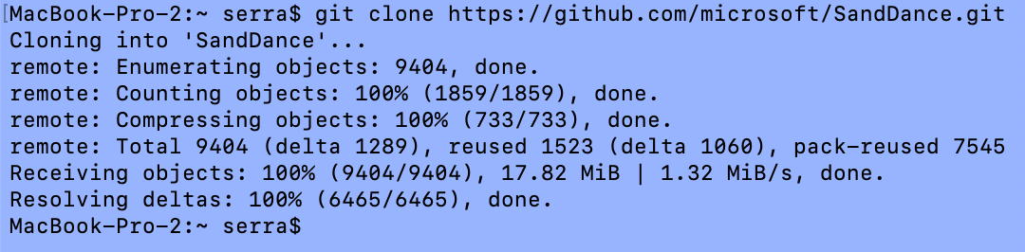
git clone [URL of the repository]
This command downloads a copy of the remote repository to your local machine.

Slide 29

git branch [new branch name]
This command will create a new branch only in your local system.
This can only be done after your first commit!

Slide 30
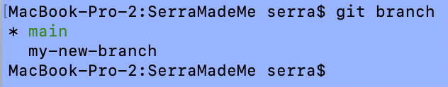
git branch
Command to view all branches of the repository.

Slide 31
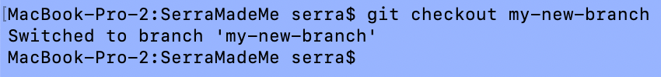
git checkout [existing branch name]
This will automatically switch you to the branch name you mentioned in the command.

Slide 32

git checkout –b [new branch name]
This will both create a new branch and automatically switch to it.

Slide 33
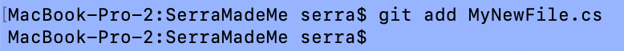
git add [file name]
This command will stage only a single file for your next commit.

Slide 34
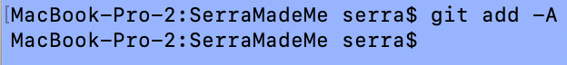
git add -A
This command stages all changed files for your next commit.

Slide 35
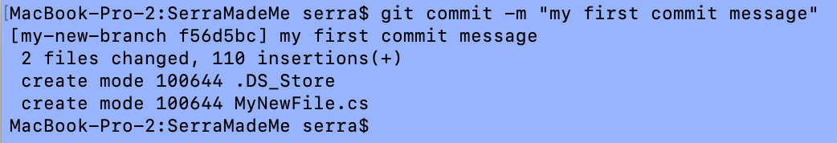
git commit -m “[message]”
This command creates a commit with all staged changes.

Slide 36
git push
This command pushes all new commits to your remote branch.
Link

Slide 37
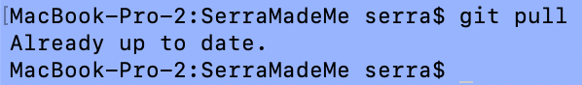
git pull
This command pulls all new commits from your remote branch onto your local branch.

Slide 38
git pull origin [existing branch name]
Takes changes from another branch and merges it into yours.
Link

Slide 39
common git commands: Overview
git init – This will transform the current directory into a Git repository. A .git sub-directory will be added. This will allow you to start recording multiple versions of your project.
git clone [URL of the repository] – This command downloads a copy of the remote repository to your local machine.
git branch [new branch name] – This command will create a new branch only in your local system.
git branch - Command to view all branches of the repository.
git checkout [existing branch name] – This will automatically switch you to the branch name you mentioned in the command.
git checkout –b [new branch name] – This will both create a new branch and automatically switch to it.
git add [file name] – This command will stage only a single file for your next commit.
git add -A – This command stages all changed files for your next commit.
git commit -m “[message]” – This command creates a commit with all staged changes.
git push – This command pushes all new commits to your remote branch.
git pull – This command pulls all new commits from your remote branch onto your local branch.
git pull origin [existing branch name] – Takes changes from another branch and merges it into yours.

Slide 40
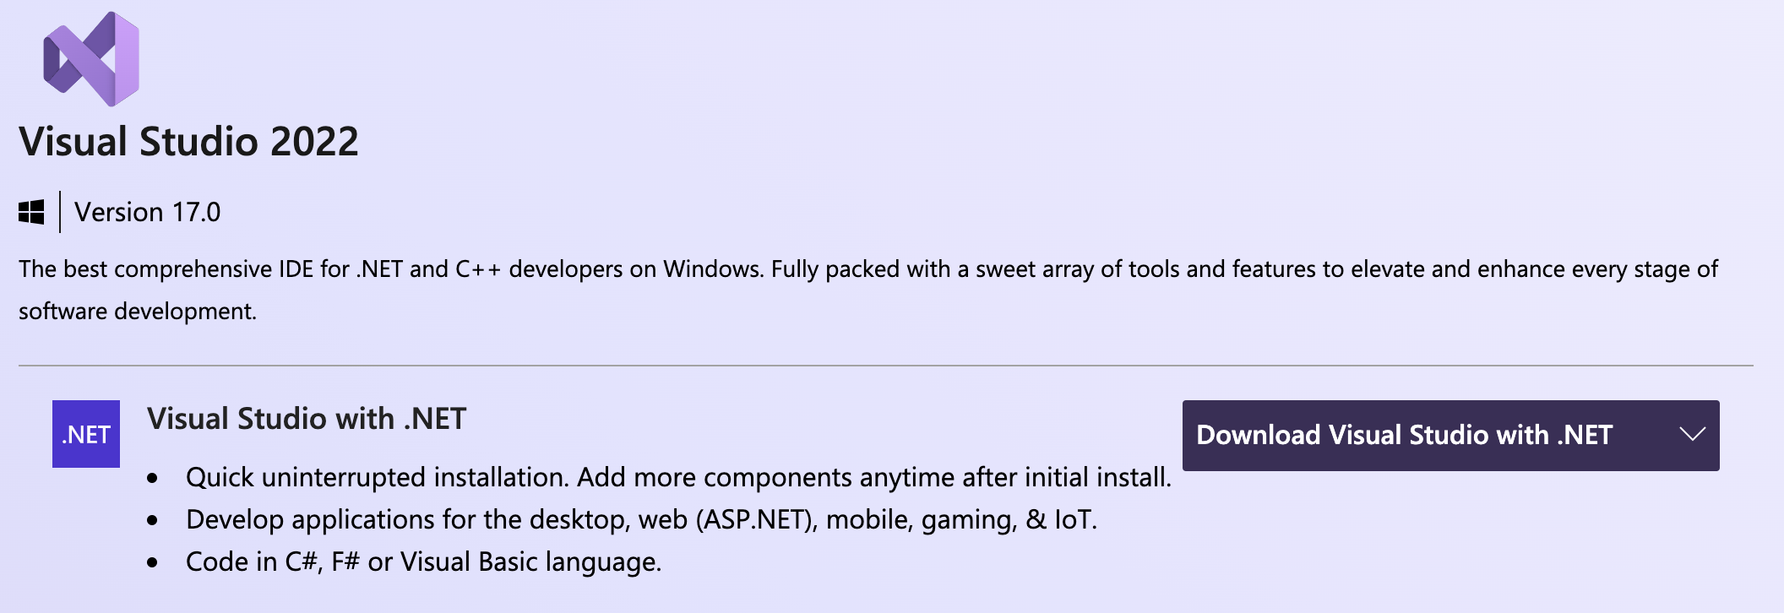

DO NOW:
Now that you know how to, create a repository for our class project titled MyApi, and be sure to implement the same settings as we did earlier.
Download Visual Studio with .NET
https://visualstudio.microsoft.com/downloads/
Set up an account on Postman
https://www.postman.com/

